Slide 1

Student Management Application
Presented by
===========
Dhanush
Saikiran
Bhavana
Pooja

Slide 2
Index
Requirement Document
Test Plan
Source code(Version 1 and 2)
Console View
Database View
Test Scenario
Test Cases
Defect Log
RTM
Modules
Project Overview

Slide 3
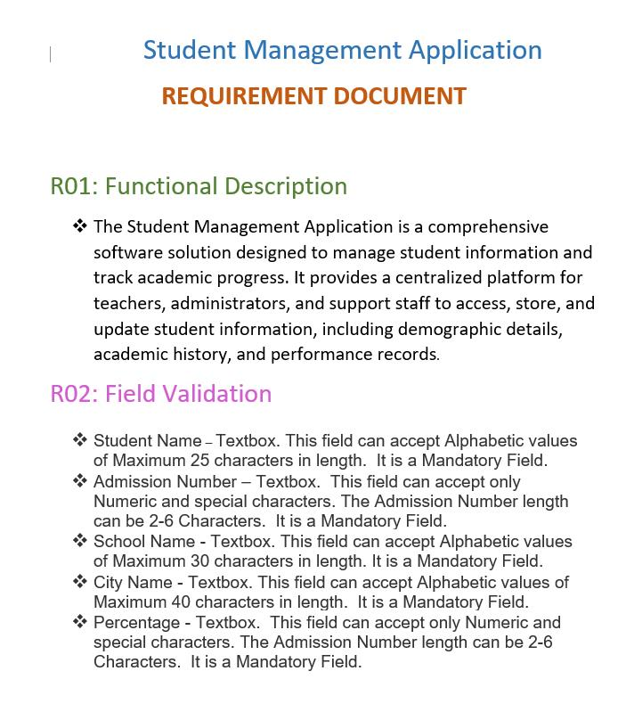
Requirement Document

Slide 4
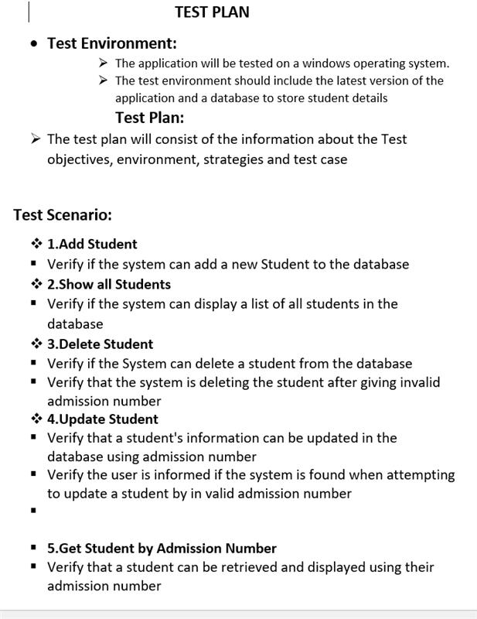
Test Plan

Slide 5
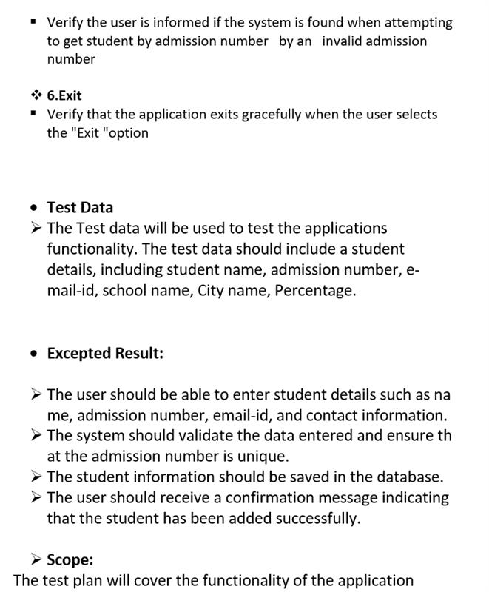
Test Plan

Slide 6
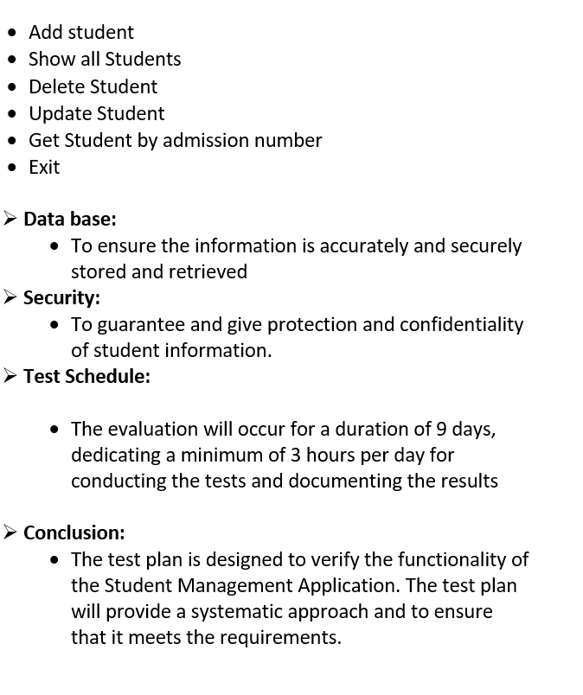
Test Plan

Slide 7
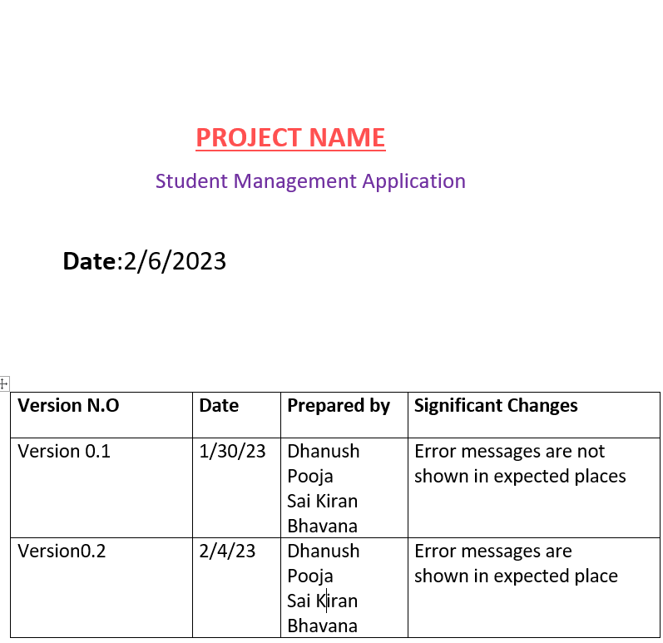
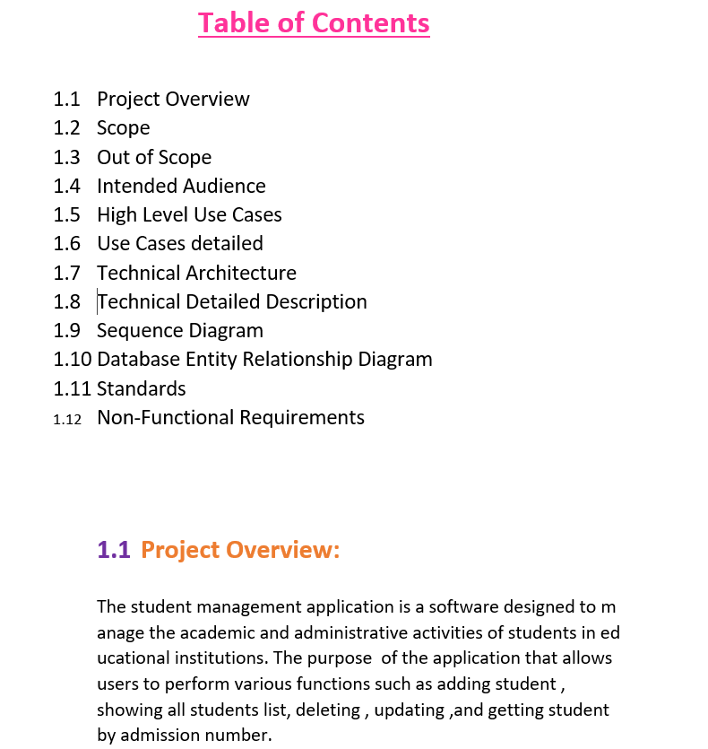
Project Template

Slide 8
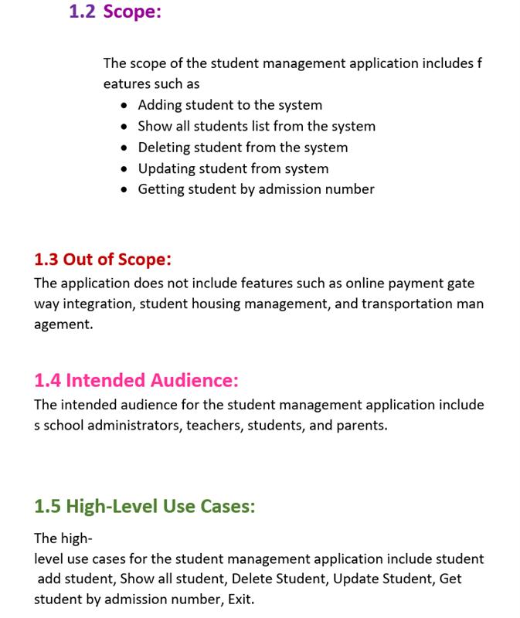
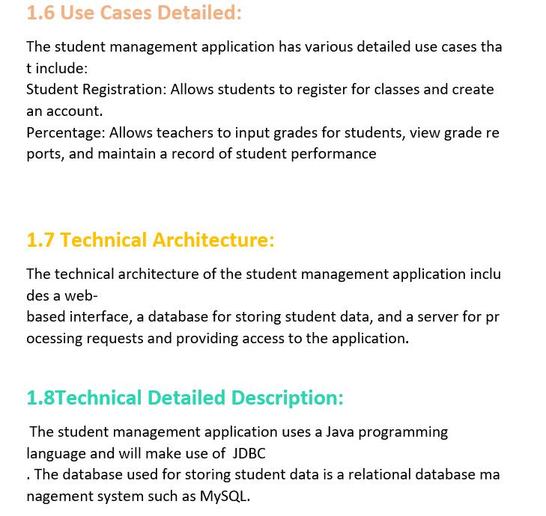
Project Template

Slide 9
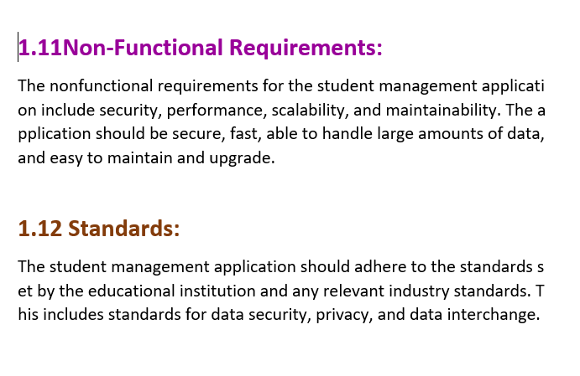
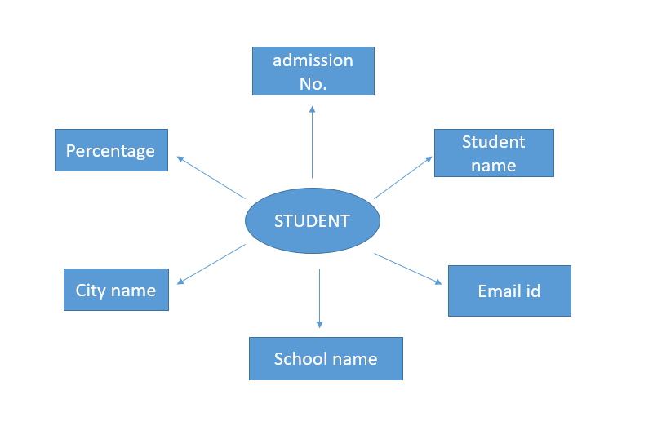
Project Template
Entity Relationship Diagram

Slide 10
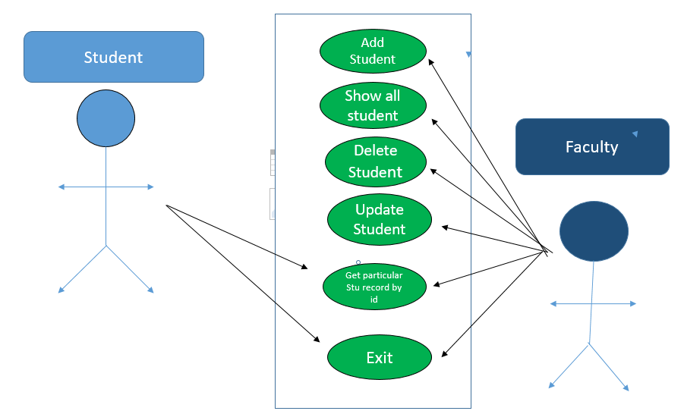
High Level Use Cases

Slide 11
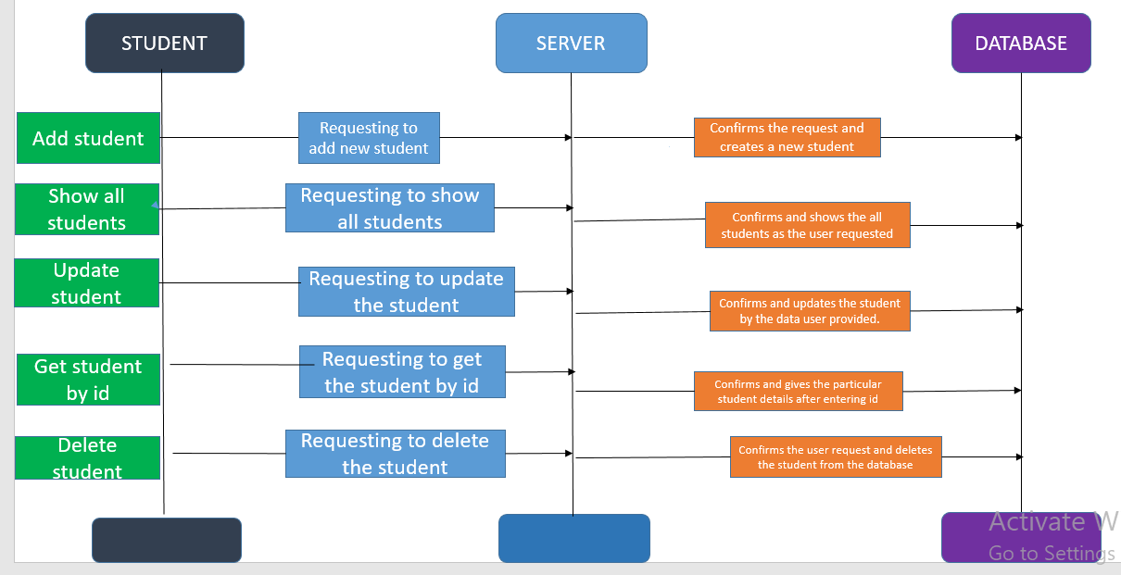
Sequence Diagram

Slide 12
Modules
Add
Add students
Show
Show All Students
Delete
Delete Student
Update
Update Student
Get
Get Student based on roll number
Exit
Exit Student

Slide 13
PROJECT OVERVIEW
The Student Management Application that helps schools keep track of student's information.
The goal of this application is to make it easier for schools to organize and access student information.
This application make management to communicate with students and parents via e-mail or SMS.

Slide 14
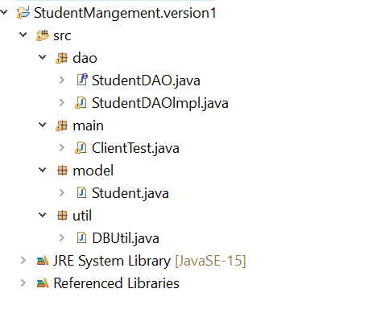
Source Code Project Structure

Slide 15
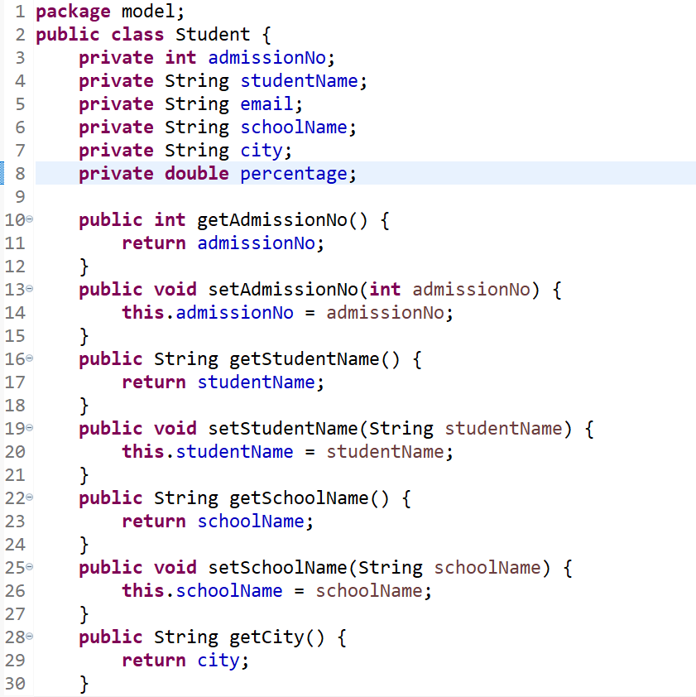
Model Class

Slide 16
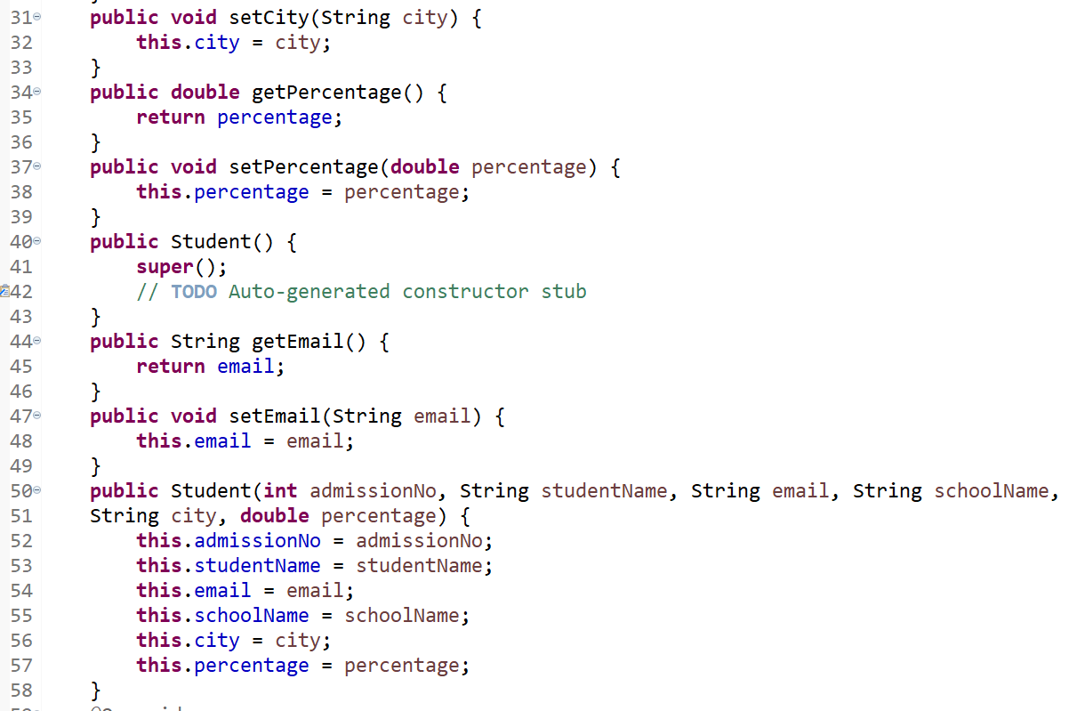
Model Class

Slide 17
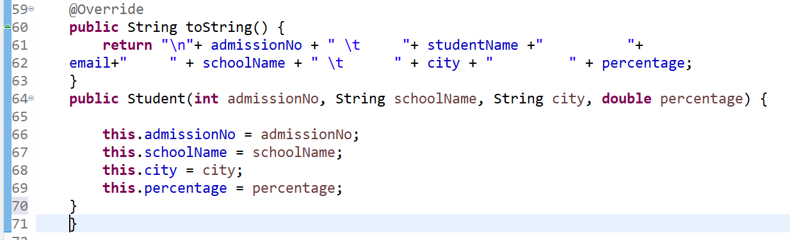

Slide 18
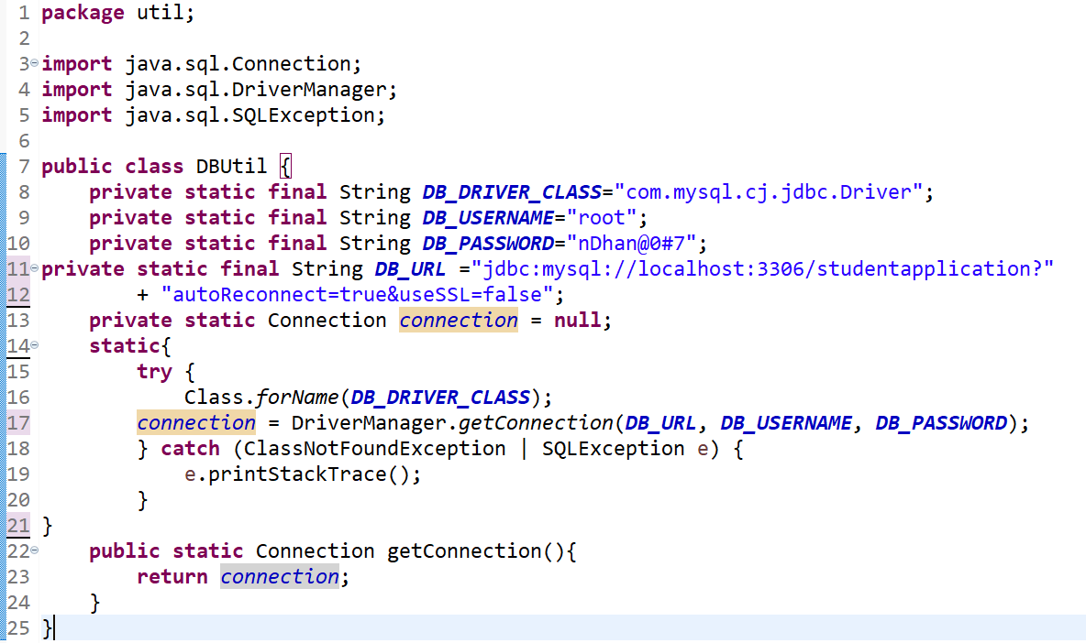
Database connection in DBUtil class

Slide 19
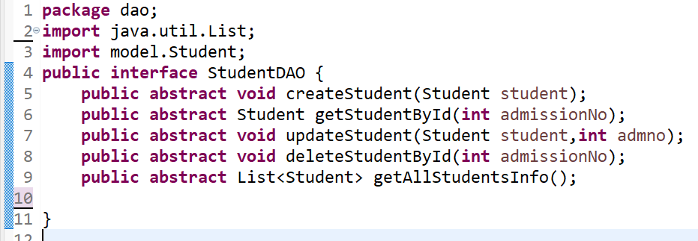
StudentDAO Interface

Slide 20
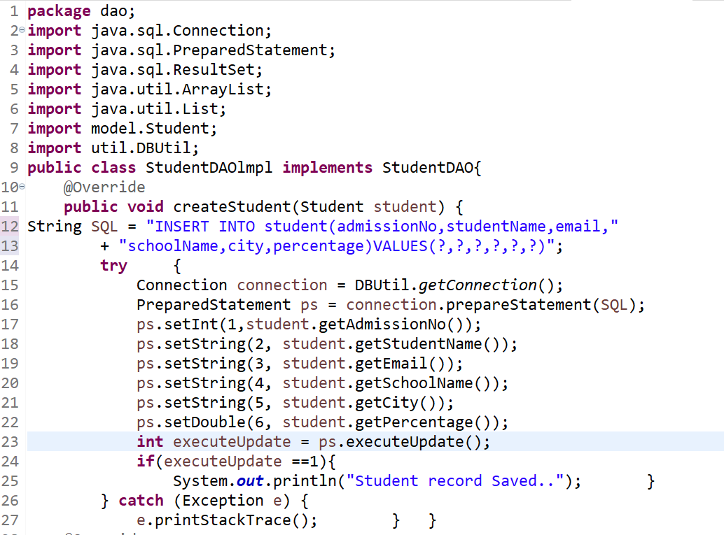
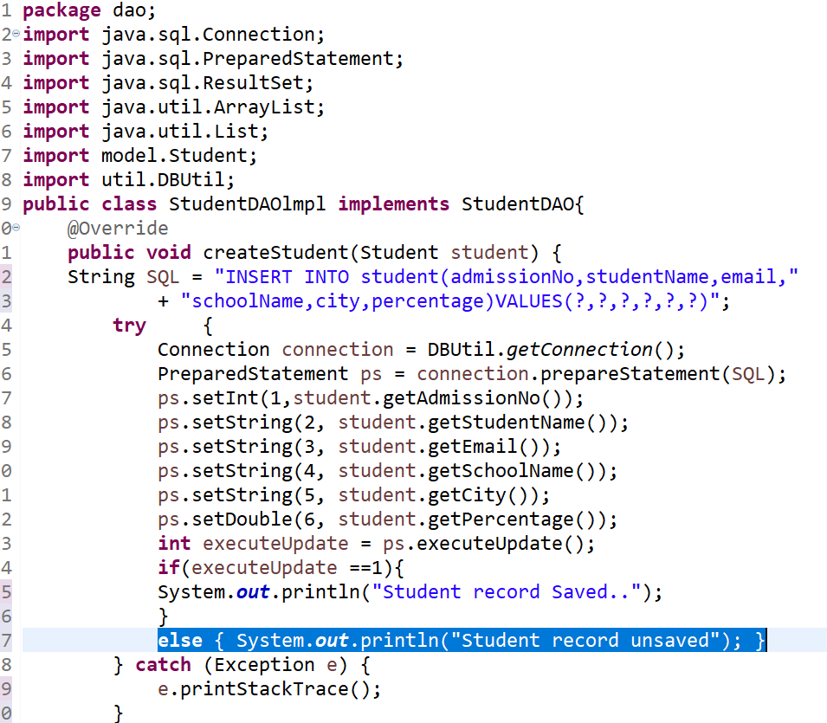
StudentDAO implements
Version 2
Version 1
.

Slide 21
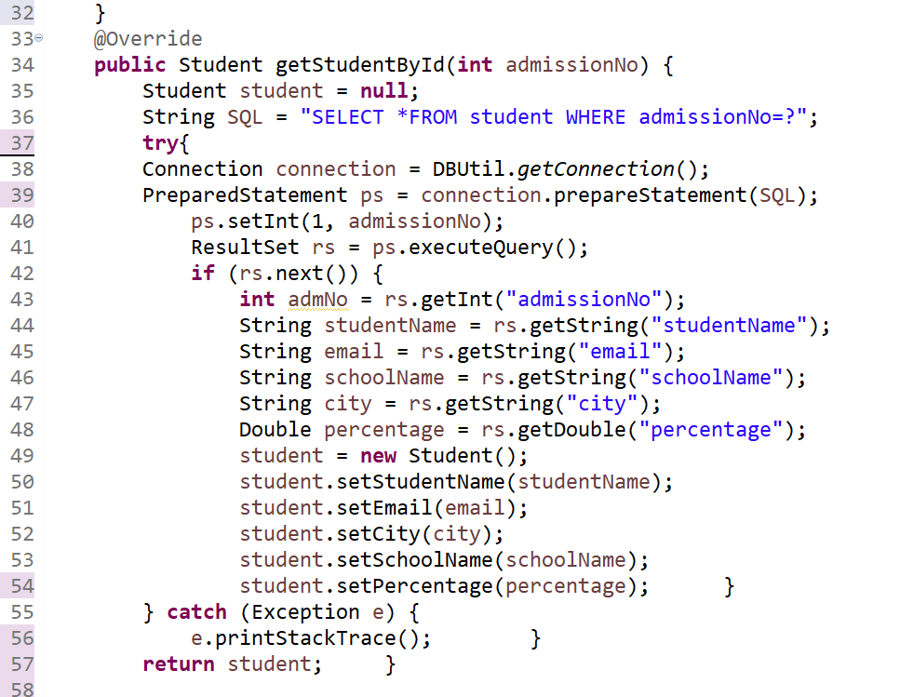
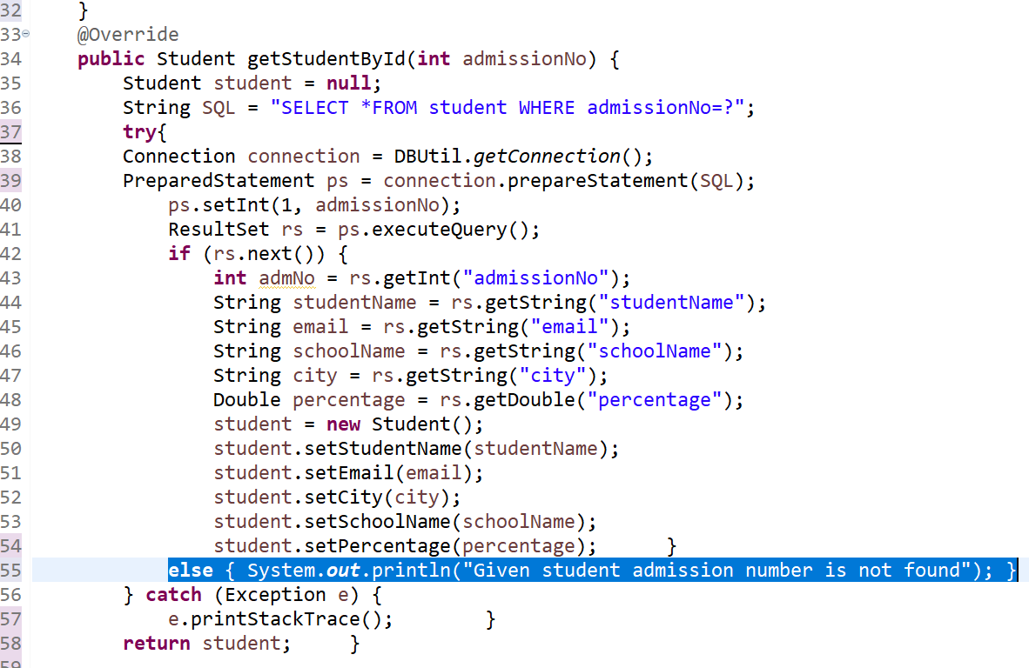
StudentDAO implements
Version 1
Version 2

Slide 22
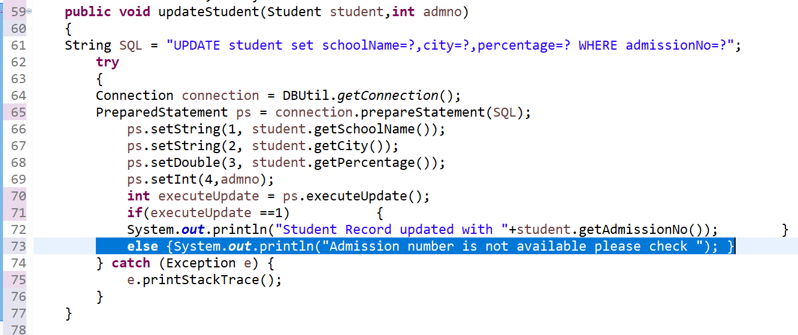
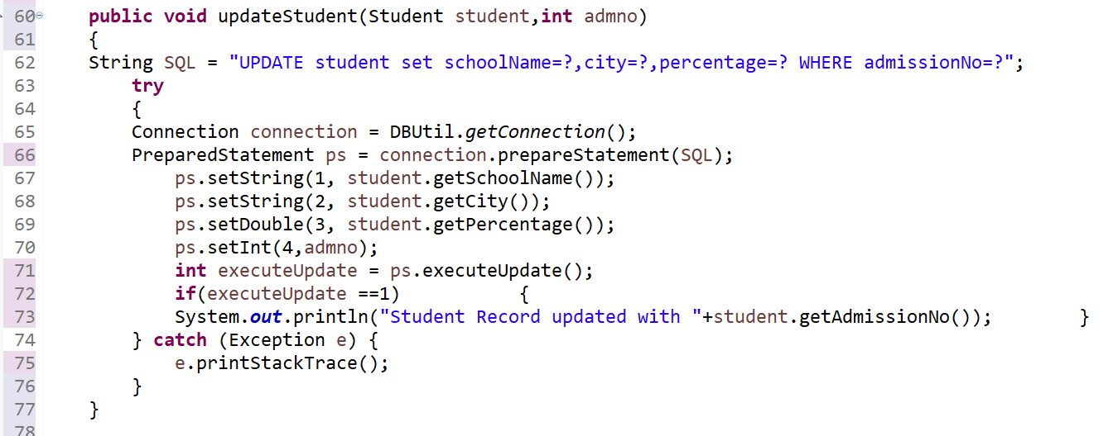
StudentDAO implements
Version 1
Version 2

Slide 23
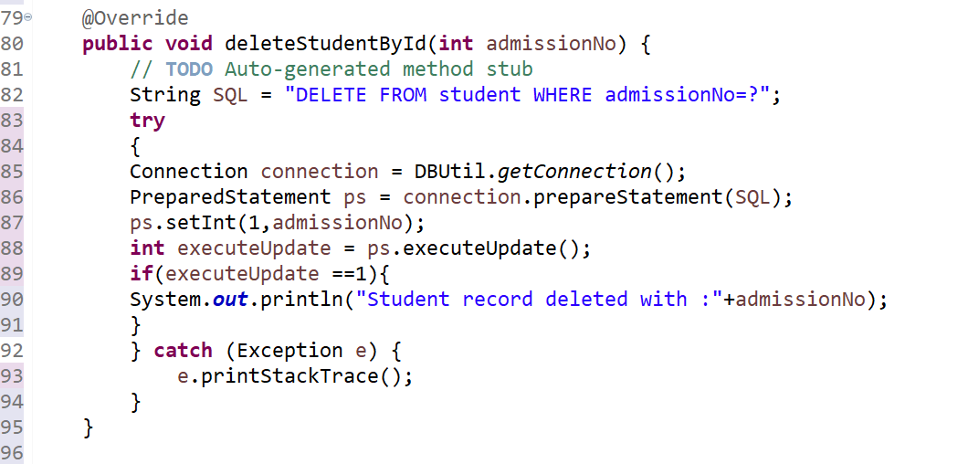
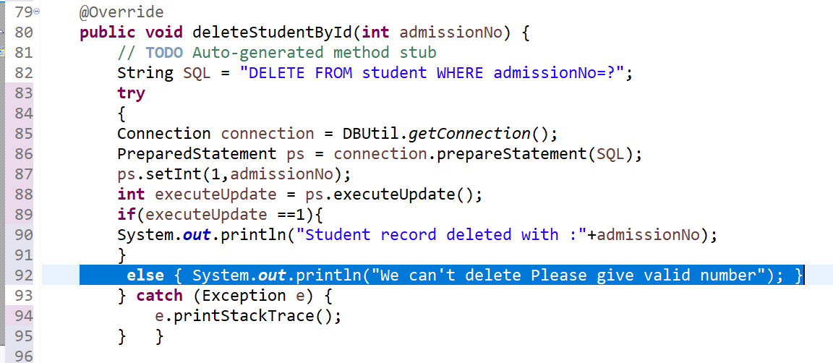
StudentDAO implements
Version 2
Version 1

Slide 24
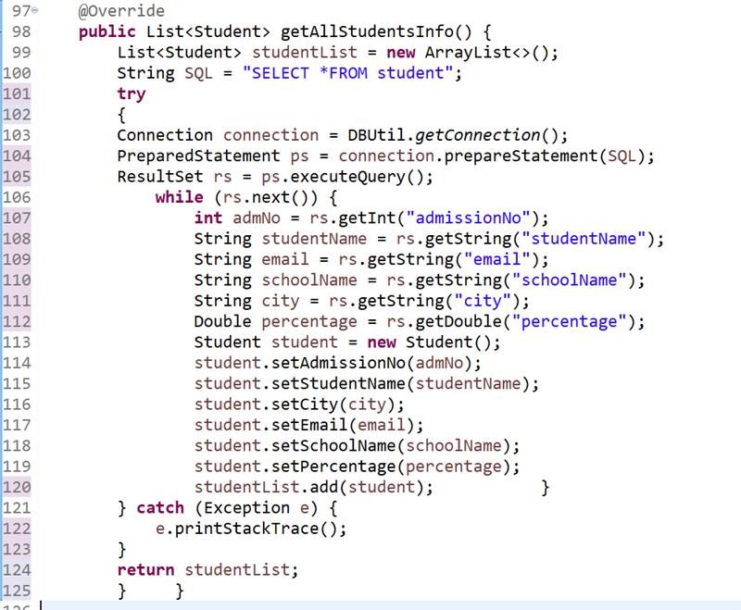
StudentDAO implements

Slide 25
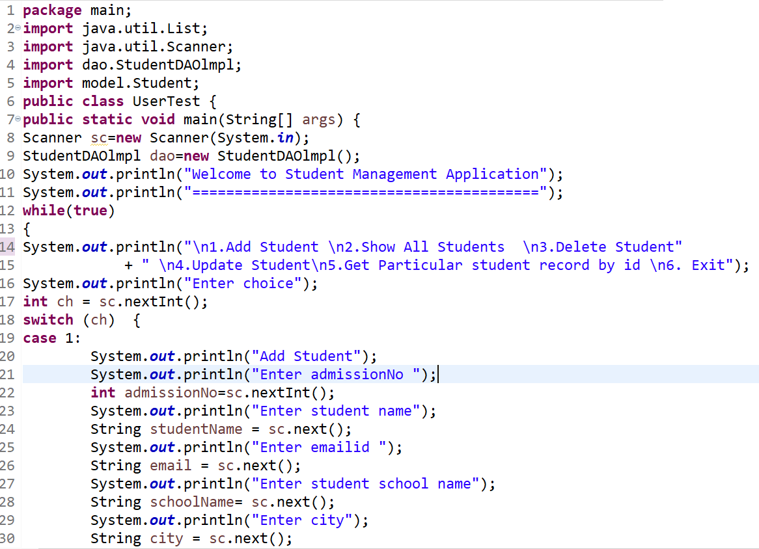
Main Class

Slide 26
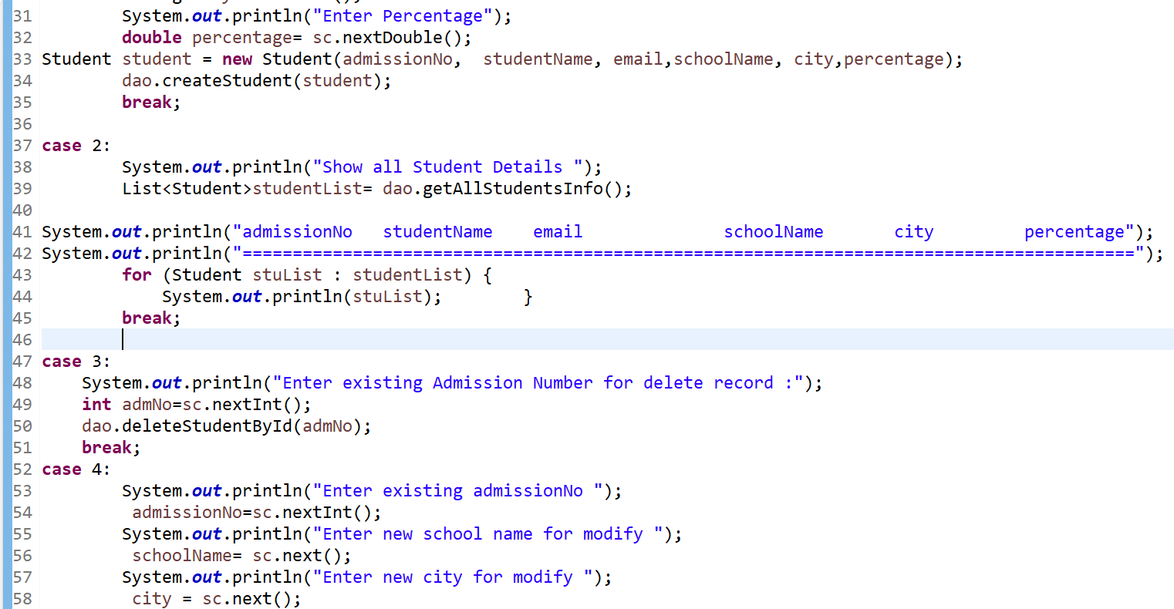
Main Class

Slide 27
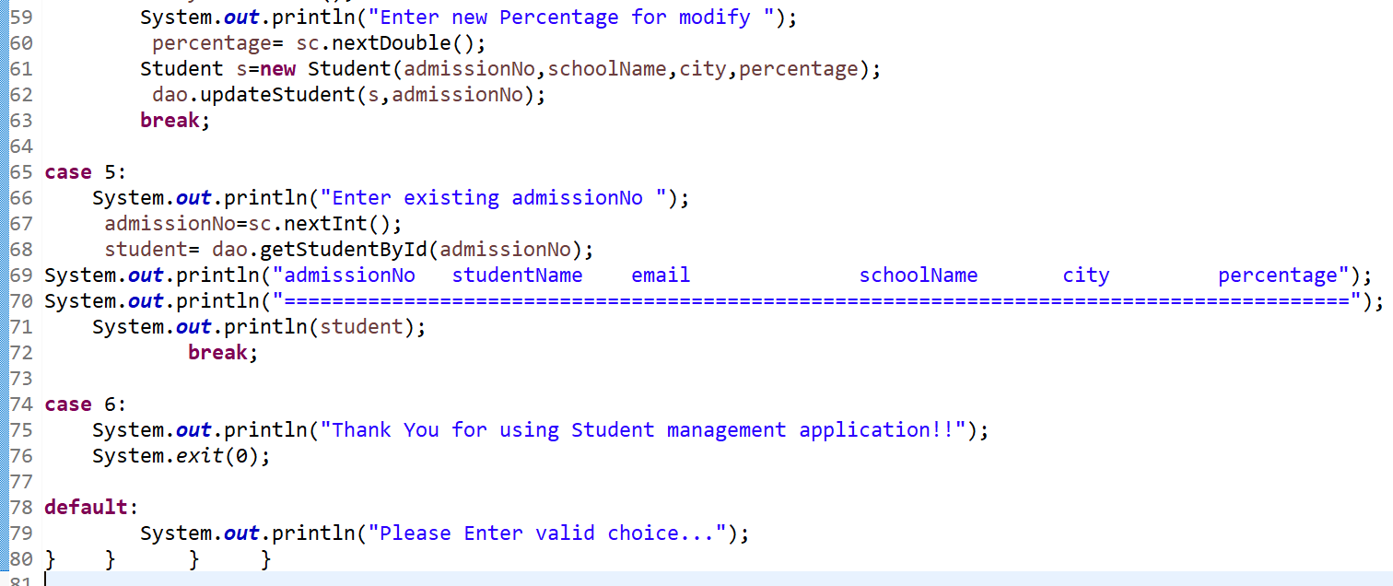
Main Class

Slide 28
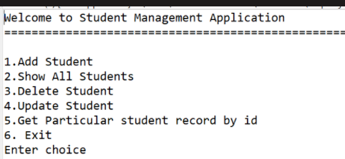
WELCOME MODULE
...

Slide 29
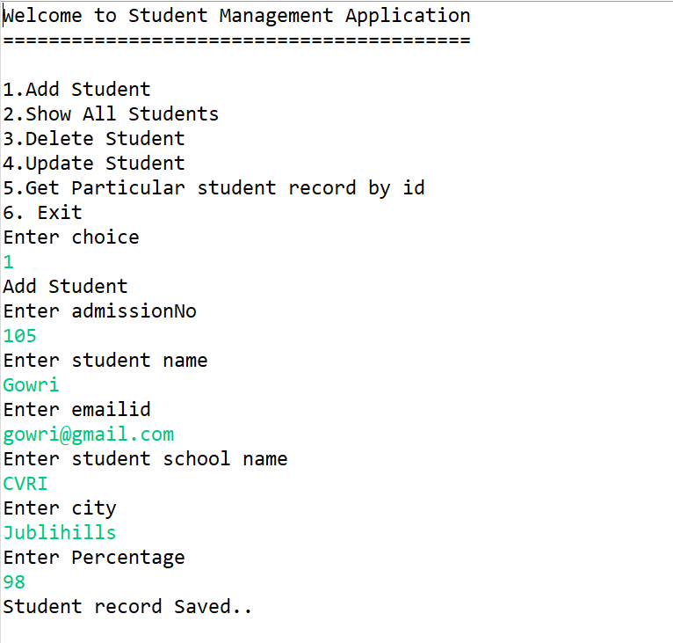
ADD STUDENTS
..

Slide 30
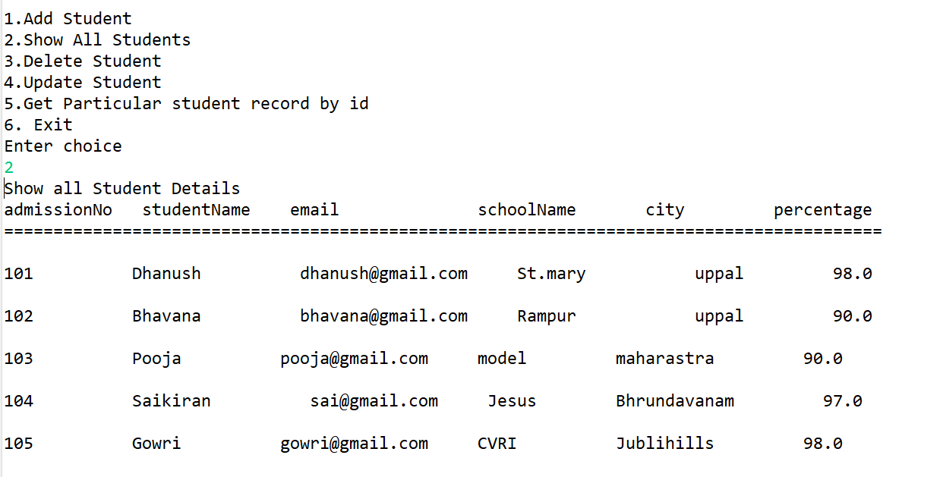
Show All Students
..

Slide 31
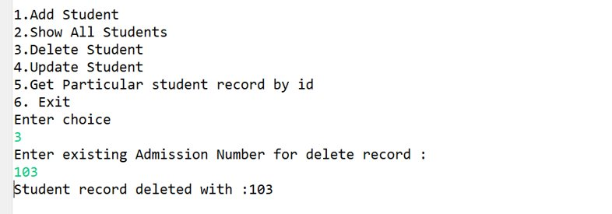
Delete Student

Slide 32
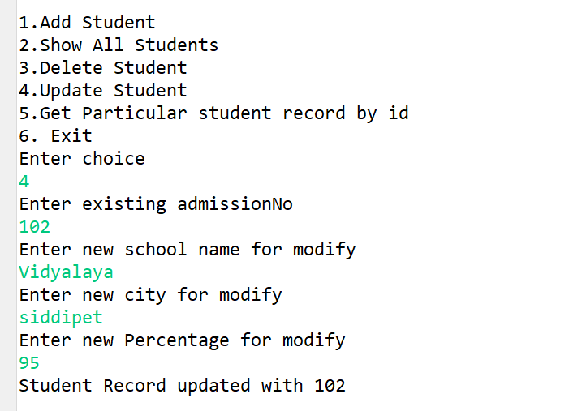
Update Student

Slide 33
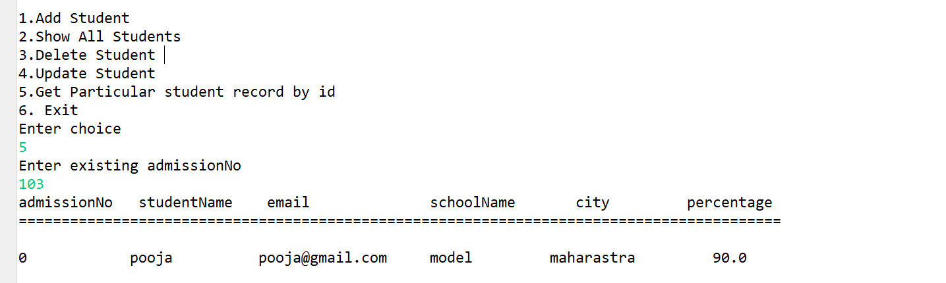
Get student based on admission no

Slide 34
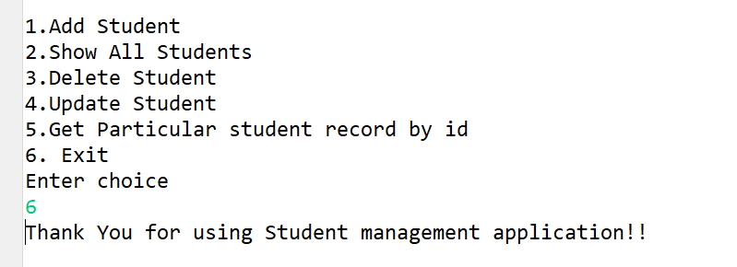
Exit

Slide 35
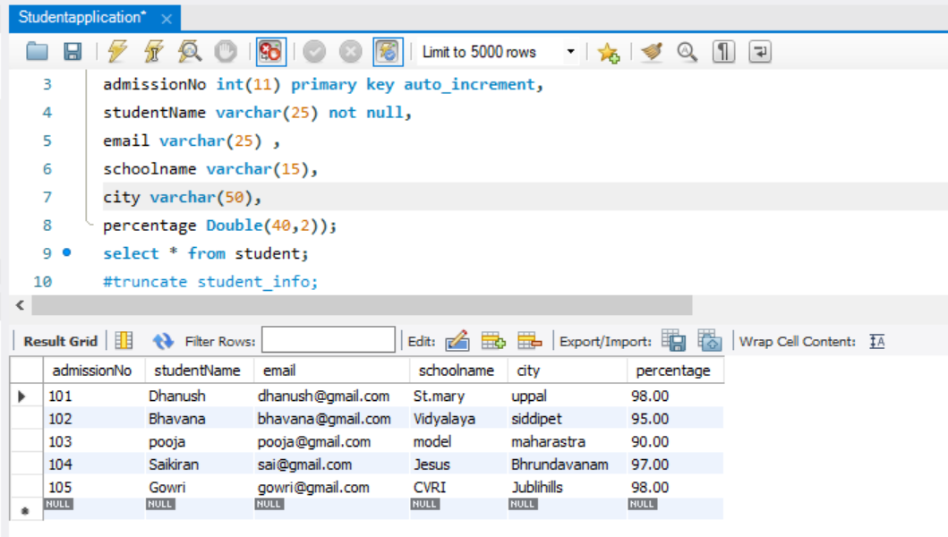
SQL DATABASE

Slide 36
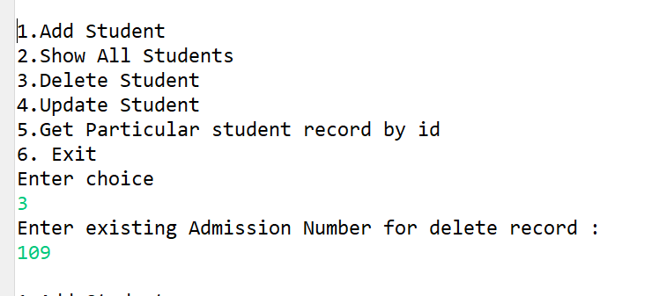
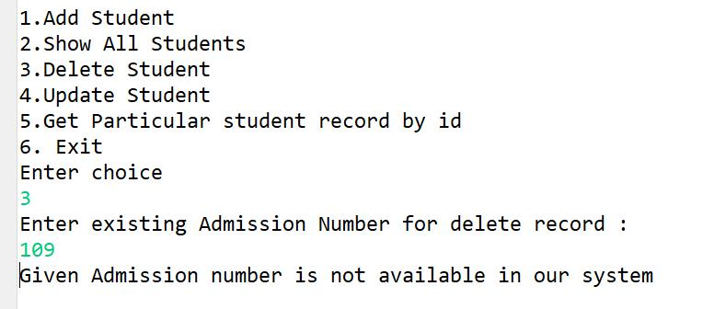
Defect in Delete Module.
Invalid
Valid

Slide 37
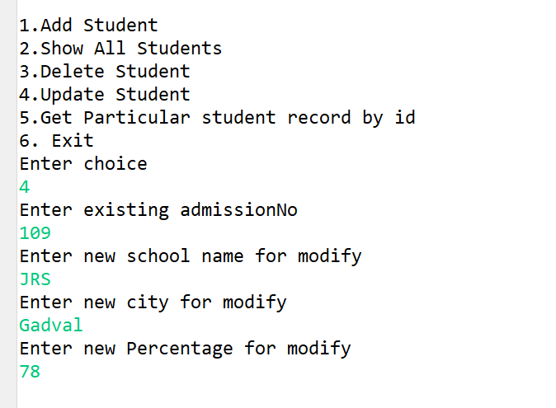
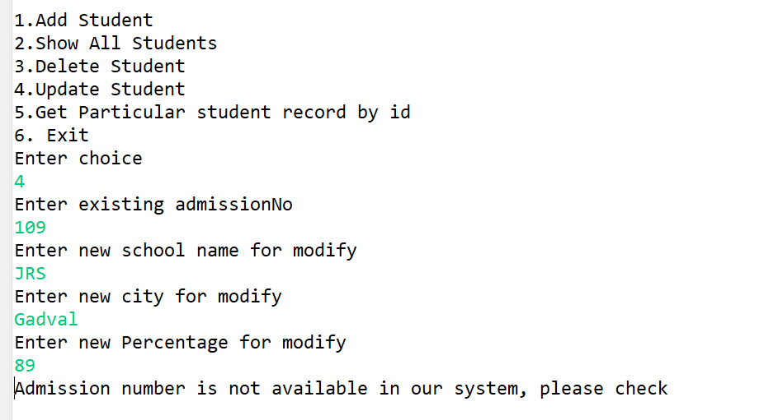
Defect In Update
Invalid
Valid

Slide 38
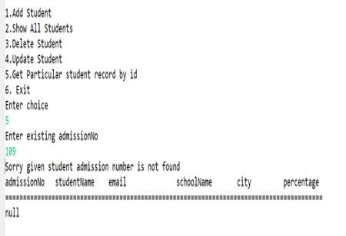
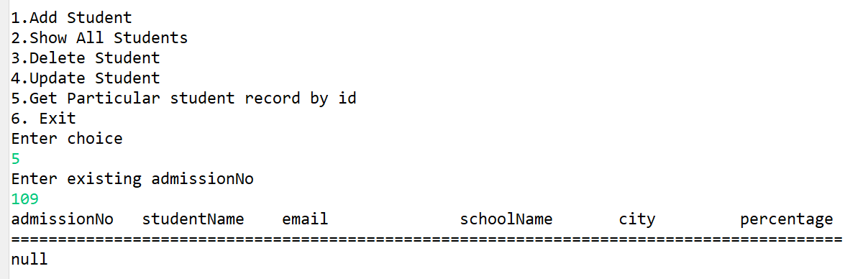
Defect in Get Student by ID
Invalid
Valid

Slide 39
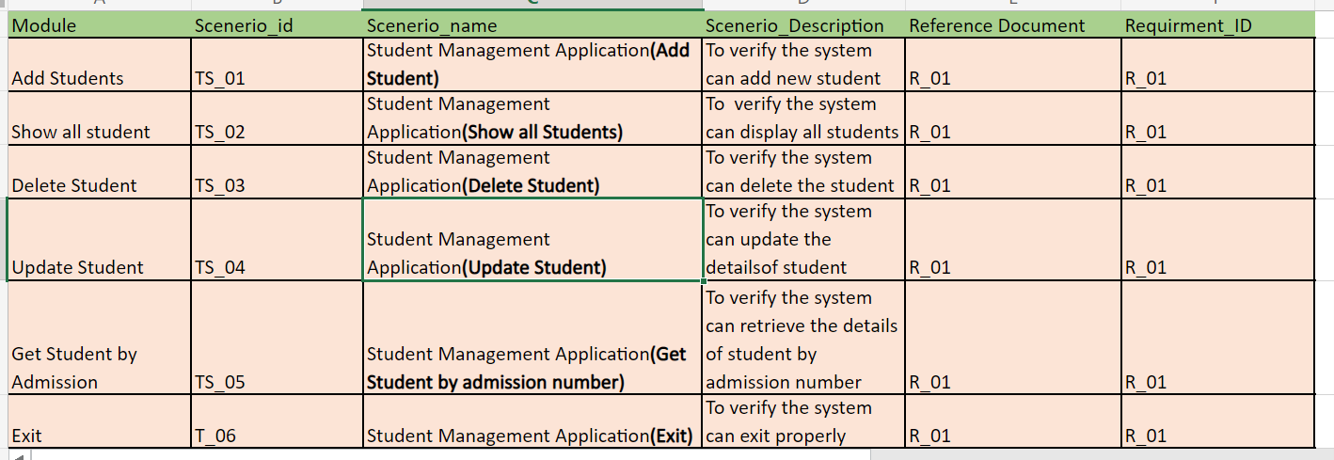
Test Scenarios

Slide 40
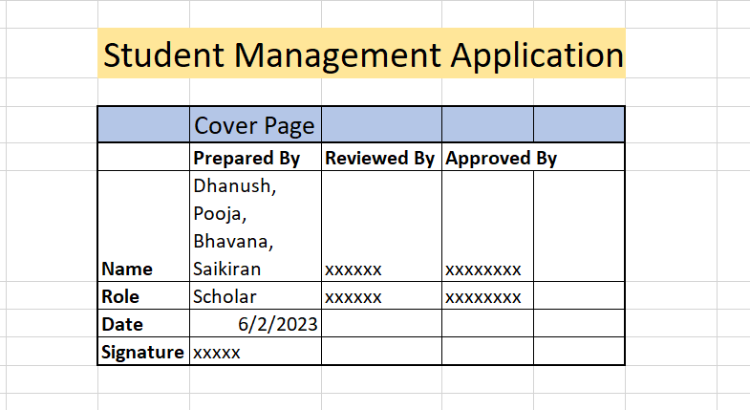
Cover Page

Slide 41
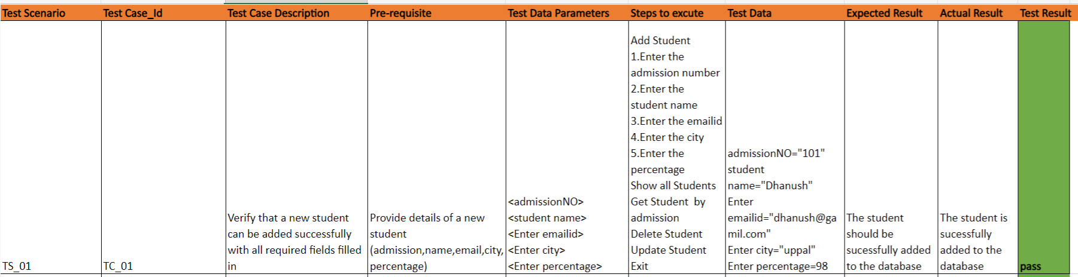
Test Case 1

Slide 42
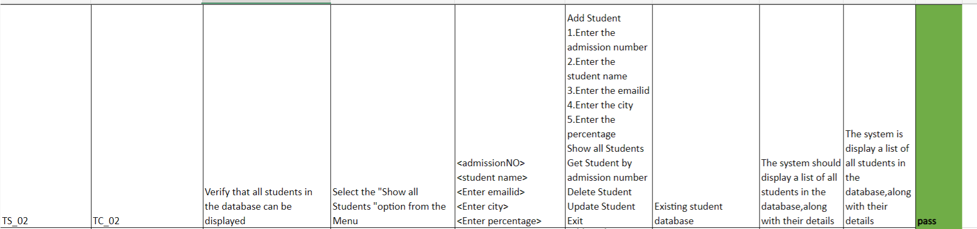
Test case 2

Slide 43
Test case 3

Slide 44
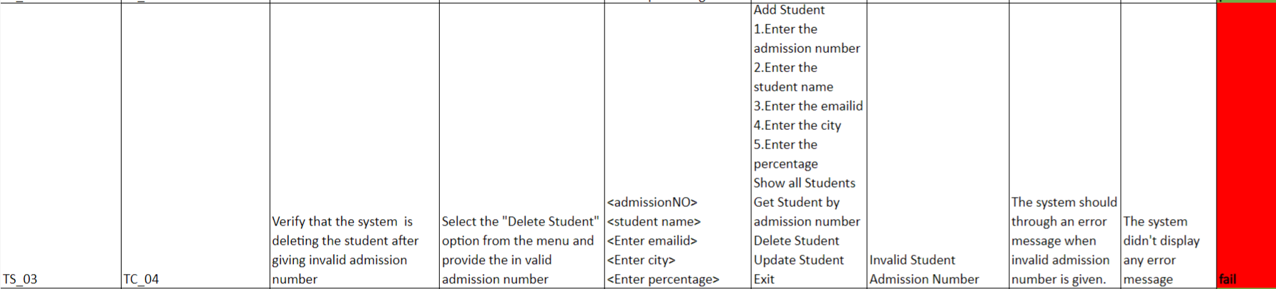
Test case 4

Slide 45
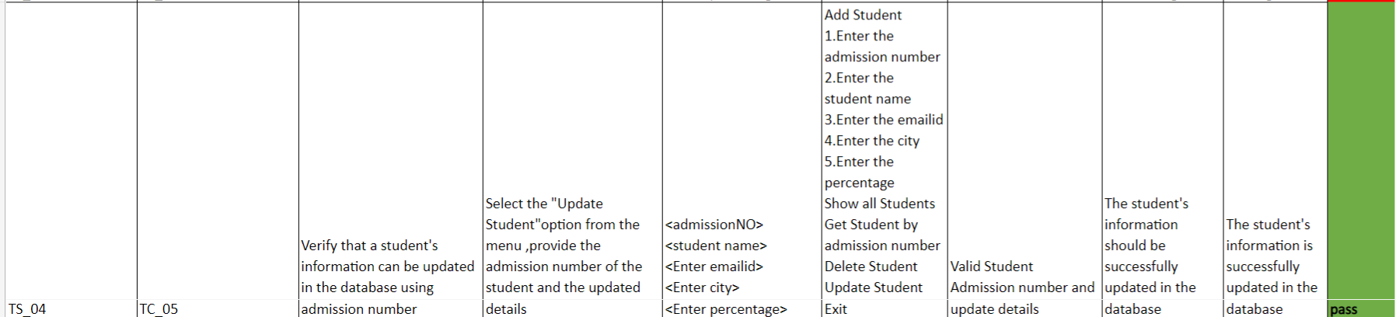
Test case 5

Slide 46

Test case 6

Slide 47

Test case 7

Slide 48

Test case 8

Slide 49

Test case 9

Slide 50

Defect Log

Slide 51

Defect Log

Slide 52

Defect Log

Slide 53

RTM

Slide 54

Automation
This Photo by Unknown author is licensed under CC BY-SA-NC.

Slide 55


Slide 56


Defects
standard_user
problem_user

Slide 57


Slide 58


Slide 59

Swag Labs Demo - Automation
Structure of the Project

Slide 60

Source Code Page Object_01

Slide 61

Page object_02

Slide 62


Page object_03

Slide 63


Page Objects_04

Slide 64


Data Provider

Slide 65

Data Provider

Slide 66


Data Provider

Slide 67


Test Case_01

Slide 68

Signing module extent report

Slide 69


Test Case_02

Slide 70

Signing module extent report

Slide 71


Test Case_03

Slide 72

Signing module extent report

Slide 73


Test Case_04

Slide 74

Product catalog module extent report

Slide 75


Test Case_05

Slide 76

Product catalog module extent report

Slide 77


Test Case_06

Slide 78

Product catalog module extent report

Slide 79


Test Case_07

Slide 80

Product catalog module extent report

Slide 81


Test Case_08

Slide 82

Purchase module extent report

Slide 83


Test Case_09

Slide 84

Purchase module extent report

Slide 85


Test Case_10

Slide 86

Purchase module extent report

Slide 87


Test Case_11

Slide 88

Purchase module extent report

Slide 89


Test Case_12

Slide 90

TestNG emailable report

Slide 91
GitHub link

Slide 92

Any Questions

Slide 93

Thank You

